Slide 1
AIR QUALITY MEASURING DEVICE CALCULATING NH3 ,NOx, CO2 USING INTERNET OF THINGS
SURIYA SUNDARAM K S (21162107012)
SRIPRASATH SATHIYAMOORTHY (2116210701261)
YAASHISH G (2116210701317)

Slide 2
Abstract
This project proposes an innovative approach utilizing Internet of Things (IoT) technology to create an efficient and accurate air quality measuring device capable of calculating concentrations of key pollutants, namely Ammonia (NH3), Nitrogen Oxides (NOx), and Carbon Dioxide (CO2). The proposed device integrates various sensors for real-time monitoring of air quality parameters. Specifically, it employs gas sensors tailored to detect NH3, NOx, and CO2 concentrations with high precision.

Slide 3
existing system
The existing systems for air quality monitoring rely on stationary stations equipped with high-precision instruments to measure pollutants like Ammonia (NH₃), Nitrogen Oxides (NOx), and Carbon Dioxide (CO₂). While these systems provide accurate and reliable data, they have several limitations. They are expensive to set up and maintain, limiting their deployment, especially in developing regions. Their stationary nature results in limited coverage, often failing to comprehensively monitor larger urban or rural areas. Real-time data accessibility is often restricted, with significant delays due to manual collection and processing. Additionally, these systems lack flexibility as they cannot easily adapt to dynamic monitoring needs or indoor environments. Public engagement is also limited, as the data is not directly accessible to the general public. These limitations highlight the need for more affordable, portable, and real-time monitoring solutions, such as the proposed IoT-based air quality measuring device, which addresses these challenges and offers a more dynamic and accessible approach to air quality monitoring.

Slide 4
proposed system
The proposed system is an IoT-based air quality measuring device designed to monitor the concentrations of Ammonia (NH₃), Nitrogen Oxides (NOx), and Carbon Dioxide (CO₂) in real-time. It uses advanced gas sensors connected to a microcontroller for data processing. The device transmits collected data for immediate analysis and visualization. Designed to be portable, cost-effective, and energy-efficient, it is suitable for various environments, including urban areas, industrial sites, and indoor spaces. The system features a user-friendly interface for easy operation and includes alert mechanisms, such way it displays the toxicity level by display three stages of alert messages such as good , poor and toxic.

Slide 5
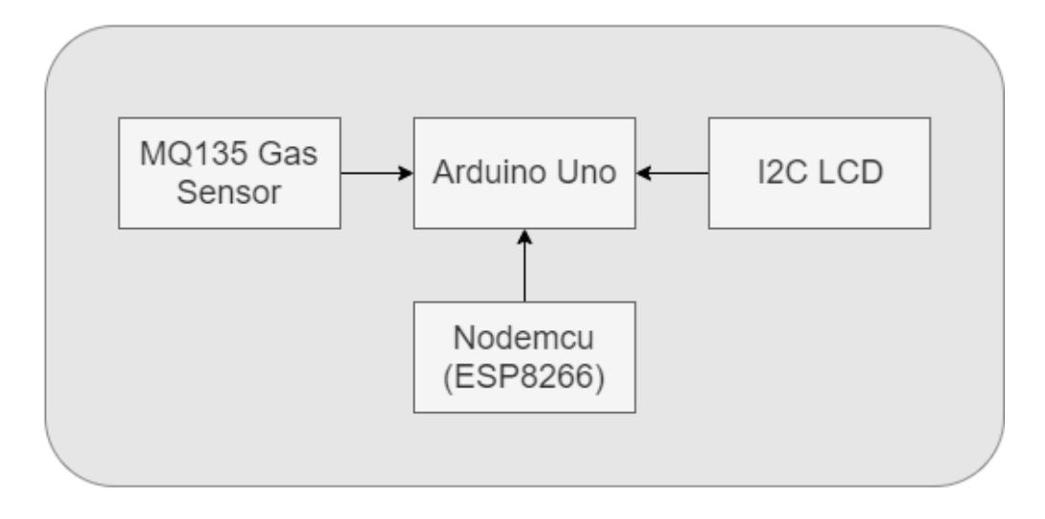
architecture

Slide 6
modules
Sensor Module
Microcontroller Module
Power Supply Module
Environmental Enclosure

Slide 7
explanation of each module
Sensor Module
This module includes gas sensors for measuring concentrations of NH3, NOx, and CO2 in the air. Each sensor is calibrated and interfaced with the microcontroller unit to provide accurate measurements..
Microcontroller Module
The microcontroller module serves as the central processing unit of the device. It collects data from the sensor module, processes it, and performs calculations to determine pollutant concentrations. Common microcontroller platforms like Arduino or Raspberry Pi are utilized for their versatility and ease of programming

Slide 8
explanation of each module
Power Supply Module
The power supply module provides the necessary electrical power to operate the device. It may include rechargeable batteries, solar panels, or power adapters, depending on the deployment environment and power requirements of the device.
Environmental Enclosure
The environmental enclosure protects the internal components of the device from weather conditions, dust, and other environmental factors. It is designed to be durable, waterproof, and resistant to corrosion, ensuring the reliability and longevity of the device in outdoor environments.

Slide 9
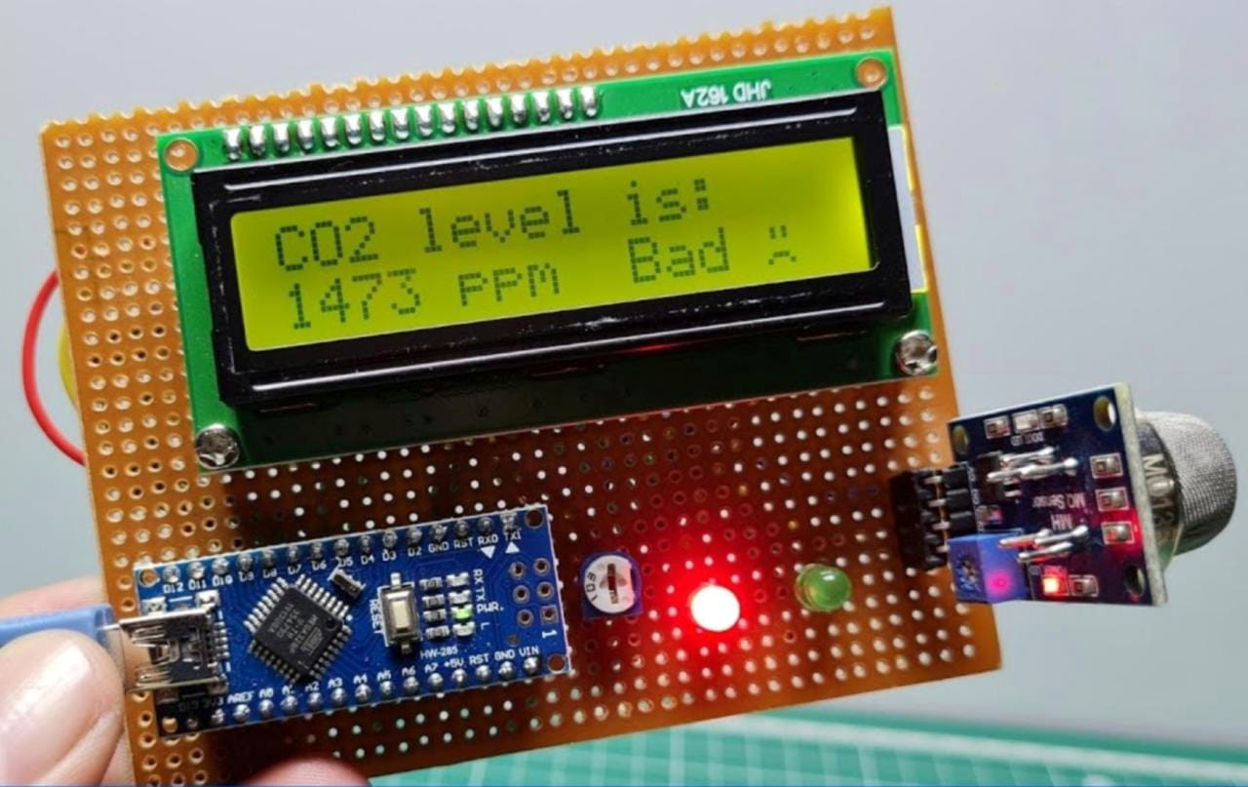
output

Slide 10
⁠conclusion and future enhancements
This project successfully developed an IoT-based air quality measuring device capable of real-time monitoring of Ammonia (NH₃), Nitrogen Oxides (NOx), and Carbon Dioxide (CO₂). Featuring advanced gas sensors and a microcontroller, the device provided accurate and immediate air quality data. Its user-friendly interface, portability, and low power consumption make it practical and flexible for diverse environments, including urban areas, industrial sites, and indoor spaces. The inclusion of alert mechanisms ensures timely warnings when pollutant levels are unsafe, enhancing public health protection. the future scope of this project is Enhancing sensor accuracy and range to detect a wider array of pollutants, such as particulate matter (PM2.5 and PM10) and volatile organic compounds (VOCs), will be crucial. Integration with smart city infrastructure can enable real-time data to inform urban planning and traffic management strategies. Incorporating data analytics and machine learning will allow for predictive capabilities, aiding proactive pollution mitigation. . In summary, integrating cloud technology into the project can enhance data management, analysis, and collaboration, significantly improving air quality monitoring and management efforts. This project highlights the potential for IoT technology to greatly advance environmental and public health outcomes.

